Slide 1

Instrumental Variables
Felipe Buchbinder

Slide 2

A refresher from our first class…

Slide 3

When an important X is missing in our model, bad things can happen.

Slide 4

When an important X
is missing in our model,
bad things can happen.

Slide 5

For example…?

Slide 6

Biased regression coefficients

Slide 7
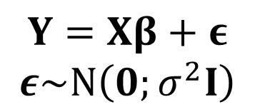
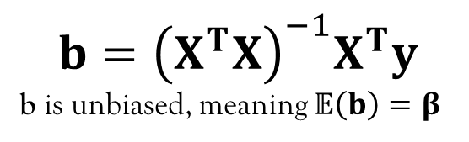
Linear Regression refresher
$$Y=Xβ+ε$$
$$ε\sim N\left(0;σ^{2}I\right)$$
$$b={\left(X^{T}X\right)}^{−1}X^{T}y$$
b is unbiased, meaning $𝔼\left(b\right)=β$

Slide 8
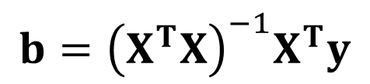
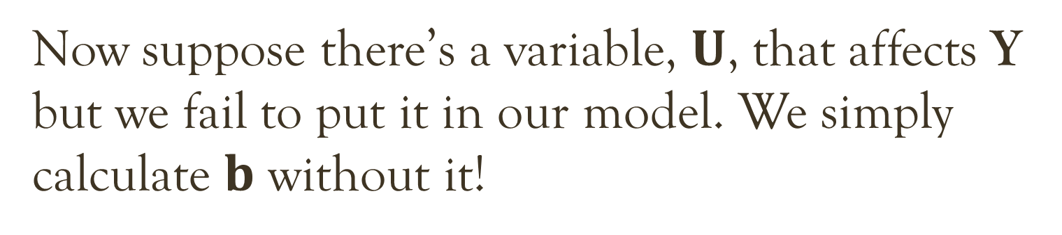
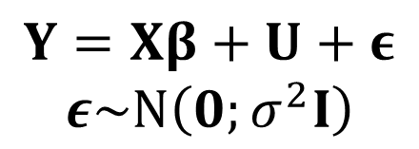
Now suppose there’s a variable, $U$, that affects Y but we fail to put it in our model. We simply calculate $b$ without it!
$$Y=Xβ+U+ε$$
$$ε\sim N\left(0;σ^{2}I\right)$$
$$b={\left(X^{T}X\right)}^{−1}X^{T}y$$

Slide 9
Now suppose there’s a variable, $U$, that affects Y but we fail to put it in our model. We simply calculate $b$ without it!
$$Y=Xβ+U+ε$$
$$ε\sim N\left(0;σ^{2}I\right)$$
$$b={\left(X^{T}X\right)}^{−1}X^{T}y$$
In this case, $b$ is no longer an unbiased estimate of $β!$

Slide 10
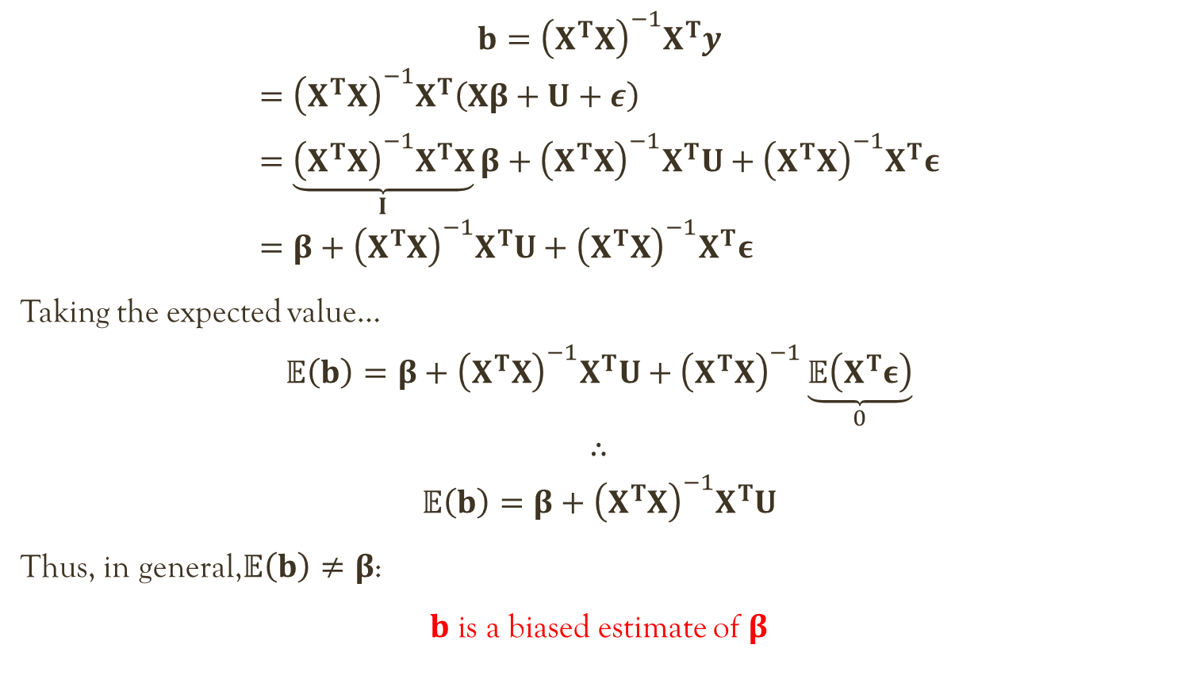
$$b={\left(X^{T}X\right)}^{−1}X^{T}y$$
$$={\left(X^{T}X\right)}^{−1}X^{T}\left(Xβ+U+ε\right) \\ =\underset{I}{\underbrace{{\left(X^{T}X\right)}^{−1}X^{T}X}}β+{\left(X^{T}X\right)}^{−1}X^{T}U+{\left(X^{T}X\right)}^{−1}X^{T}ε \\ =β+{\left(X^{T}X\right)}^{−1}X^{T}U+{\left(X^{T}X\right)}^{−1}X^{T}ε$$
Taking the expected value…
$$𝔼\left(b\right)=β+{\left(X^{T}X\right)}^{−1}X^{T}U+{\left(X^{T}X\right)}^{−1}\underset{0}{\underbrace{𝔼\left(X^{T}ε\right)}}$$
$$∴$$
$$𝔼\left(b\right)=β+{\left(X^{T}X\right)}^{−1}X^{T}U$$
Thus, in general,$𝔼\left(b\right)≠β$:
$b$ is a biased estimate of $β$

Slide 11

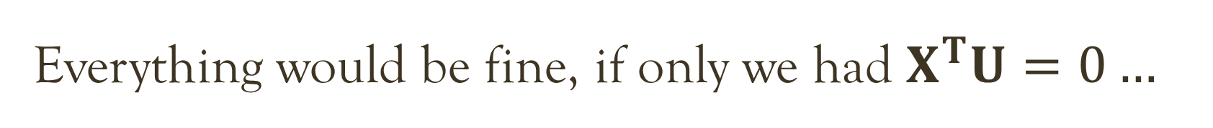
Everything would be fine, if only we had $X^{T}U=0…$
$$b=β+{\left(X^{T}X\right)}^{−1}X^{T}U$$

Slide 12


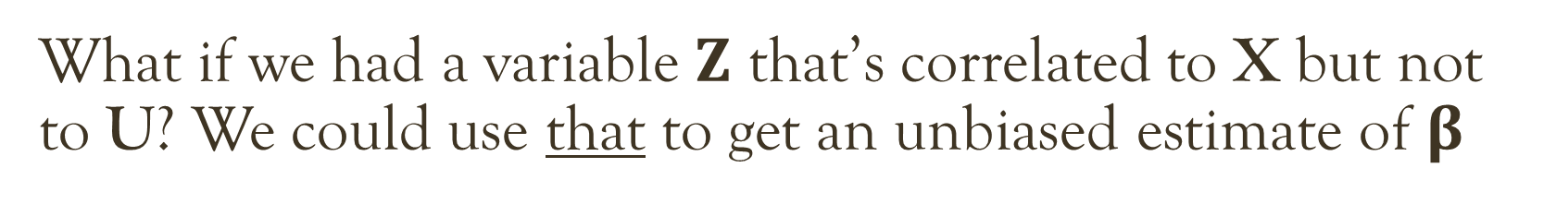
Everything would be fine, if only we had $X^{T}U=0…$
$$b=β+{\left(X^{T}X\right)}^{−1}X^{T}U$$
What if we had a variable $Z$ that’s correlated to X but not to U? We could use that to get an unbiased estimate of $β$

Slide 13

Instrumental Variable
An instrumental variable is a variable that affects $Y$ only through X.
Mathematically, this means it is correlated to X but not to U.

Slide 14
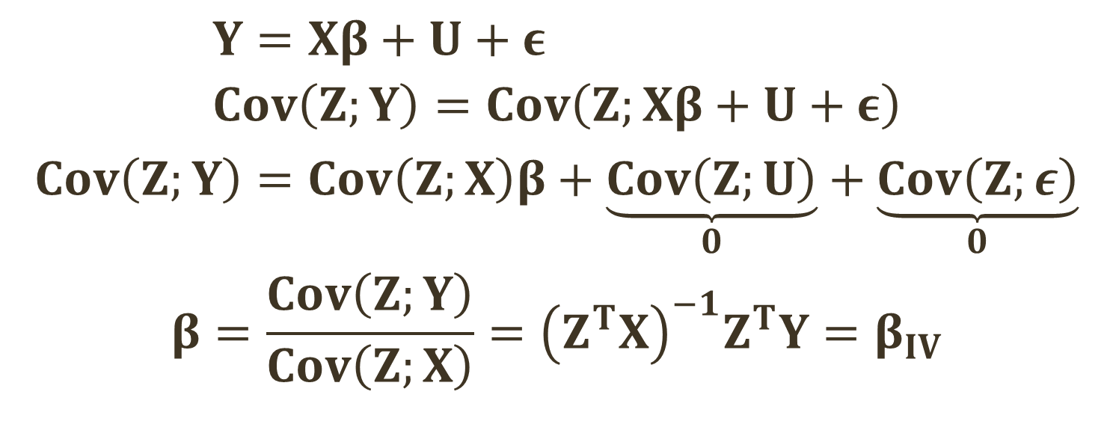
Instrumental variable estimator
$$Y=Xβ+U+ε \\ Cov\left(Z;Y\right)=Cov\left(Z;Xβ+U+ε\right)$$
$$Cov\left(Z;Y\right)=Cov\left(Z;X\right)β+\underset{0}{\underbrace{Cov\left(Z;U\right)}}+\underset{0}{\underbrace{Cov\left(Z;ε\right)}}$$
$$β=\frac{Cov\left(Z;Y\right)}{Cov\left(Z;X\right)}={\left(Z^{T}X\right)}^{−1}Z^{T}Y=β_{IV}$$

Slide 15
Effect of smoking on health
Smoke?
Health
What variables may I be omitting here?

Slide 16
Effect of smoking on health
Smoke?
Health
?
Stress
?
?
?

Slide 17
Effect of smoking on health
Smoke?
Health
?
Anxiety
?
?
?

Slide 18
Effect of smoking on health
Smoke?
Health
?
Poverty
?
?
?

Slide 19
Effect of smoking on health
Smoke?
Health
What characteristics must a variable have to
work as an instrument in this case?

Slide 20
Effect of smoking on health
Smoke?
Health
Can you think of any variable
that we could use as an instrument?

Slide 21
Effect of smoking on health
Smoke?
Health
Smoke
Tax

Slide 22
Effect of smoking on health
Smoke?
Health
Cigarette tax affects a person’s health only by affecting how much s/he smoke. It is uncorrelated to all other things that affect health.
Smoke
Tax

Slide 23
Pearl’s (2000) conditions for a good instrument
The equations of interest are "structural," not "regression".
The instrument Z should be independent of U.
($Z^{T}U=0$)
The instrument Z should be independent of U.
(𝐙^𝐓 𝐔=0)
The instrument Z should not affect Y when X is held constant
(exclusion restriction)
The instrument Z should not be independent of X.
($Z^{T}X≠0$)
The instrument Z should not be independent of X.
(𝐙^𝐓 𝐗≠0)
The error term U stands for all exogenous factors that affect Y when X is held constant.

Slide 24



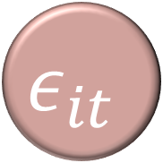

Representation as a Bayesian Causal Network
$$Z_{it}$$
$$X_{it}$$
$$U_{i}$$
$$Y_{it}$$
$$ε_{it}$$

Slide 25


Weak instruments (Bound, Jaeger & Baker, 1995)
$Corr\left(Z;X\right)$ is low
Can lead to even more biased coefficients than simply ignoring the problem of omitted variables and running plain, old, OLS.
Can also lead to inflated standard errors (impact on $p$-values?)

Slide 26
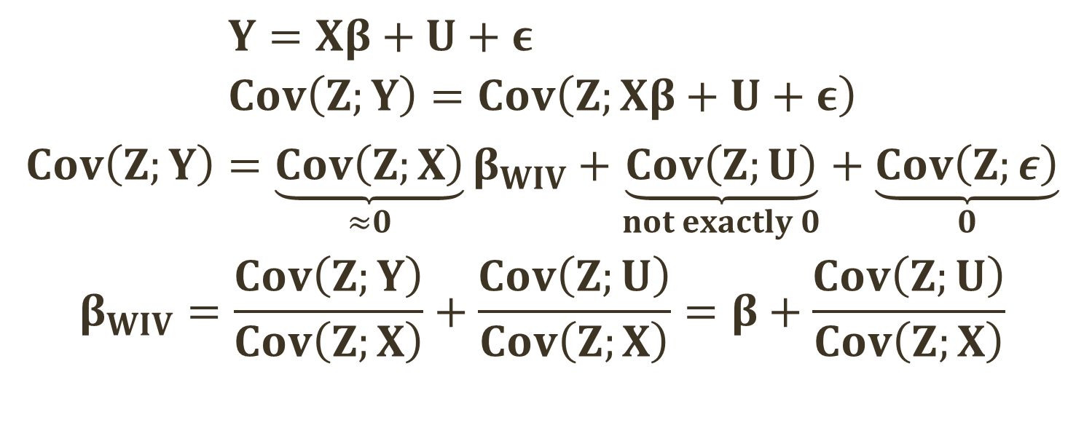
Weak instruments yield biased coefficients (1/2)
$$Y=Xβ+U+ε \\ Cov\left(Z;Y\right)=Cov\left(Z;Xβ+U+ε\right)$$
$$Cov\left(Z;Y\right)=\underset{≈0}{\underbrace{Cov\left(Z;X\right)}}β_{WIV}+\underset{not exactly 0}{\underbrace{Cov\left(Z;U\right)}}+\underset{0}{\underbrace{Cov\left(Z;ε\right)}}$$
$$β_{WIV}=\frac{Cov\left(Z;Y\right)}{Cov\left(Z;X\right)}+\frac{Cov\left(Z;U\right)}{Cov\left(Z;X\right)}=β+\frac{Cov\left(Z;U\right)}{Cov\left(Z;X\right)}$$

Slide 27
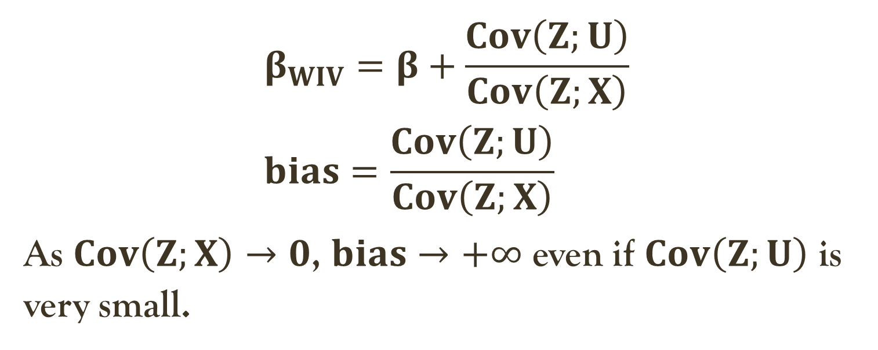
Weak instruments yield biased coefficients (1/2)
$$β_{WIV}=β+\frac{Cov\left(Z;U\right)}{Cov\left(Z;X\right)} \\ bias=\frac{Cov\left(Z;U\right)}{Cov\left(Z;X\right)}$$
As $Cov\left(Z;X\right)→0$, $bias→+∞$ even if $Cov\left(Z;U\right)$ is very small.

Slide 28

Weak instruments yield inflated standard errors
$$β_{IV}={\left(Z^{T}X\right)}^{−1}Z^{T}Y$$
$$V\left(β_{IV}\right)={\left(Z^{T}X\right)}^{−1}σ^{2}→+∞$$
$$as Z^{T}X=Cov\left(Z;X\right)→0$$

Slide 29
What are your thoughts on the method of instrumental variables? Can it make good music?
Notes:
Discuss how hard it is to find good instruments, and why that has constrained the widespread use of this method.

